Slide 1
New Baking Books
2024

Slide 2

Pie Academy
Pie Recipes
Lots of Pictures

Slide 3

Baking
Intro to Baking Program – Wednesday, 12:00 PM
Notes:
Remember Mary is teaching

Slide 4
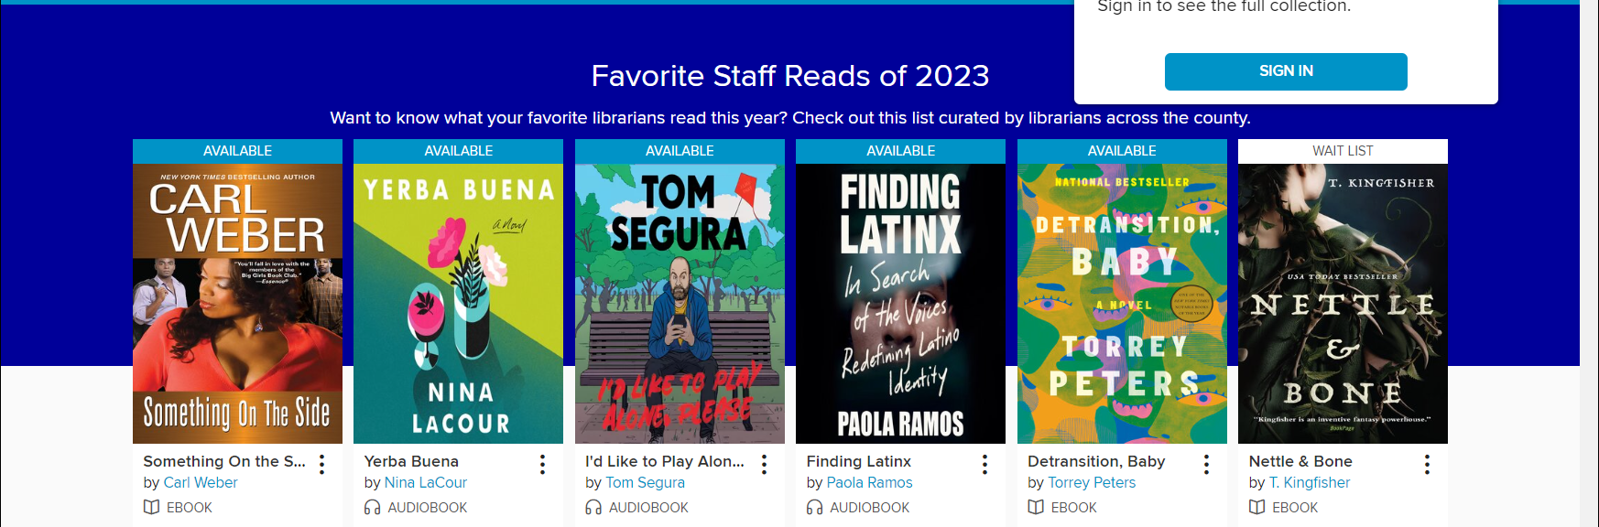
Screenshot

Slide 5
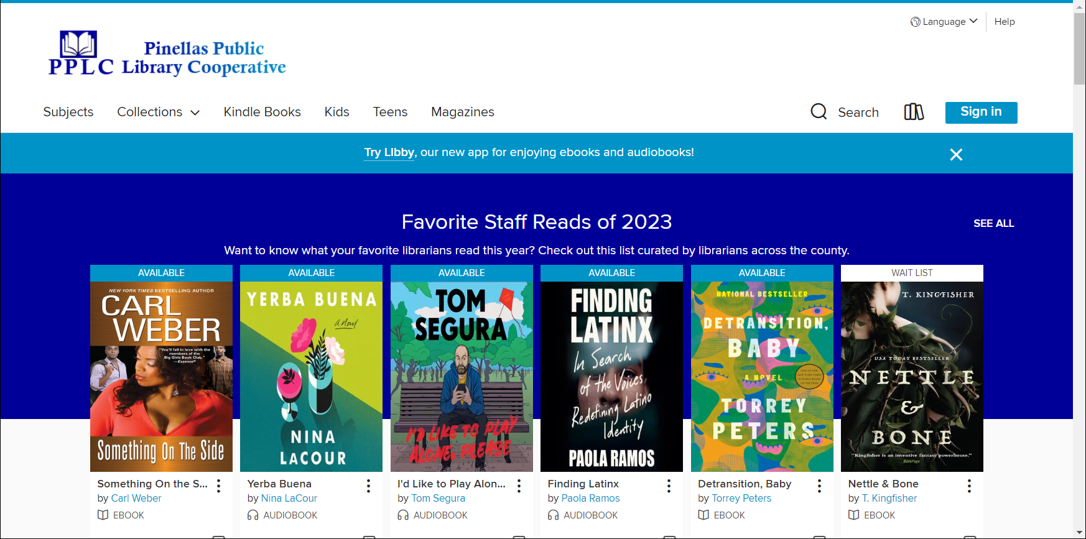
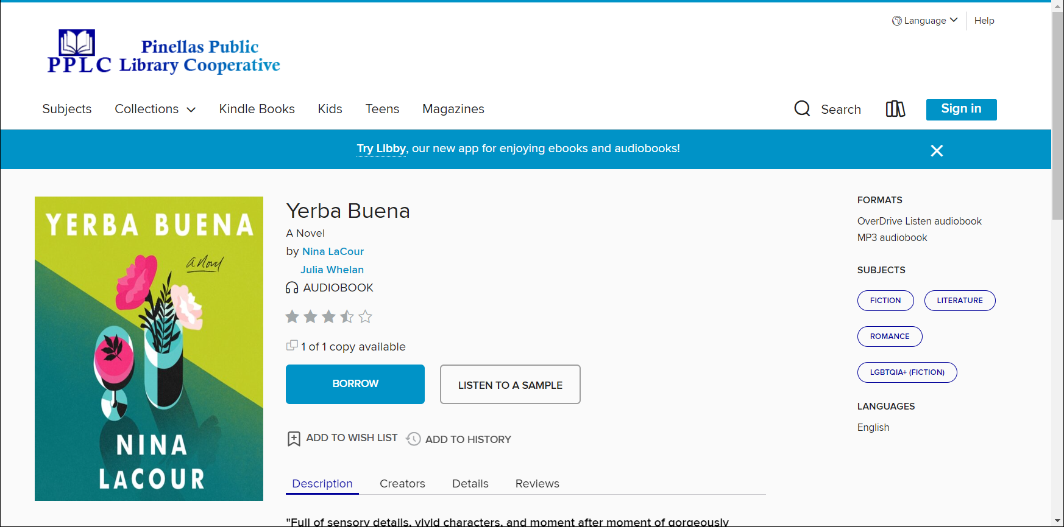
Downloading a book

Slide 6
How to download
Login to Overdrive
Select Title

Slide 7
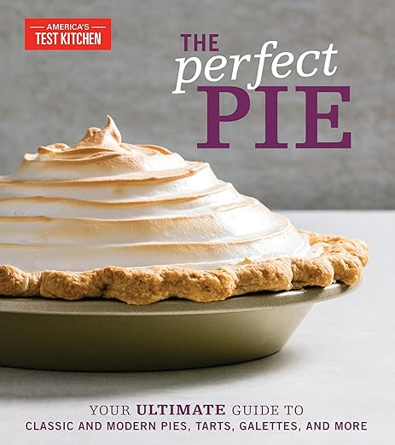


Try Aligning these together – vertically and horizontally

